Slide 1
CHAPTER 12 (Part 2)
Abstract Data Type

Slide 2
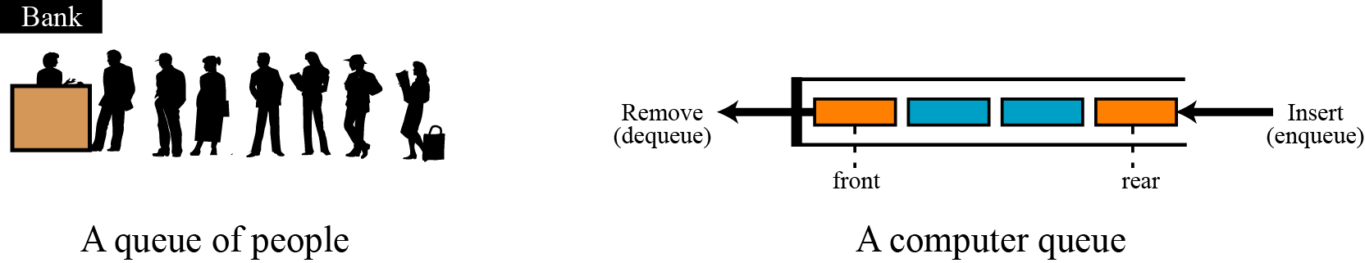
12-3 QUEUES
A queue is a restricted linear list
Data can only be inserted at one end, the rear
Data can only be deleted from the other end, the front
Data is processed through queue in order it is received
Queues are first in, first out (FIFO) data structures
Figure 12.8 Two representation of queues

Slide 3
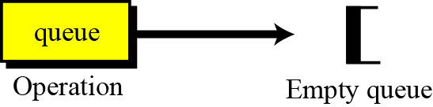
12.3.1 Operations on queues
Four basic operations
The queue, enqueue, dequeue, and empty operations
The queue operation
The queue operation creates an empty queue
Figure 12.9 The queue operation

Slide 4

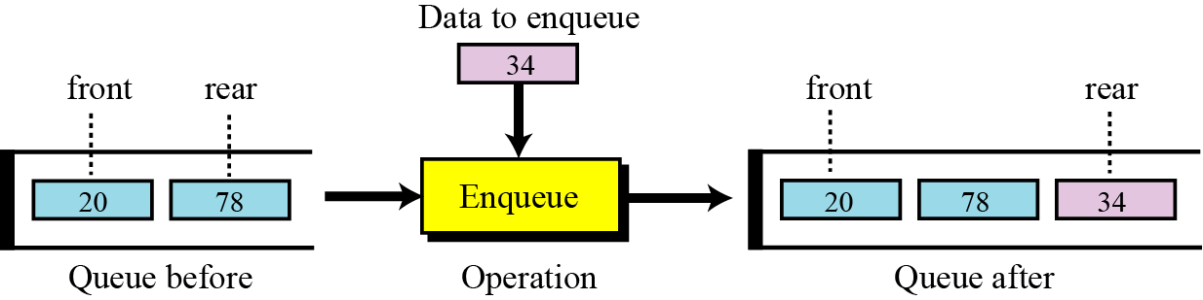
The enqueue operation
The enqueue operation inserts an item at rear of queue
Figure 12.10 The enqueue operation

Slide 5
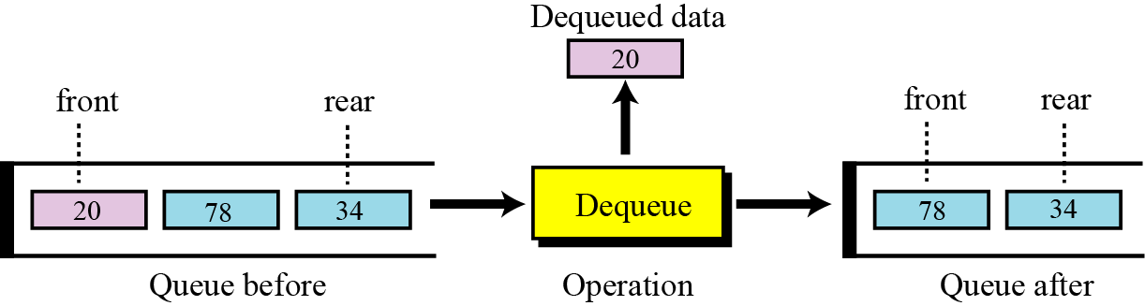
The dequeue operation
The dequeue operation deletes the item at front of queue
Figure 12.11 The dequeue operation

Slide 6
The empty operation
The empty operation checks the status of the queue
Returns true if the queue is empty
Returns false if the queue is not empty

Slide 7
12.3.2 Queue ADT
We define a queue as an ADT as shown below:

Slide 8
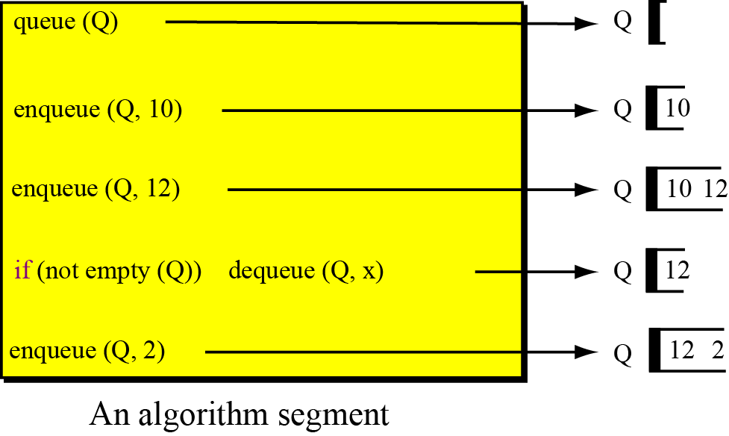
Example 12.4
A segment of an algorithm that applies the previously defined operations on a queue Q
Figure 12.12 Example 12.4
x: 10
x: 10

Slide 9
12.3.3 Queue applications
Queues are one of the most common of all ADTs
They are found in virtually every operating system and network and in countless other areas
For example, queues are used in
Online business applications such as processing customer requests, jobs, and orders
In a computer system, queues are used to
Process jobs
For system services such as print spools

Slide 10
Example 12.5
Organize databases by a data characteristic, using queues
For example
We have a list of sorted data in two categories
Data values less than 1000
Data values greater than or equal to 1000
We can use two queues to
Separate the categories
Also maintain the order of data in each category

Slide 12
Algorithm 12.3 Example 12.5 (continued)

Slide 13
Example 12.6
A queue can adjust and create a balance between
A fast producer of data
A slow consumer of data
For example, if a CPU is connected to a printer
Printer speed is slower than CPU speed
If CPU waits for printer to print data from CPU
CPU would be idle for a long time
Solution is a queue
CPU creates as many data chunks as queue can hold and sends them to queue
CPU is now free to do other jobs
Data chunks dequeued slowly and printed
Queue is normally called a spool queue

Slide 14
12.3.4 Queue implementation
At the ADT level
We use the queue and its four operations
At the implementation level
We need to choose a data structure to implement it
Queue ADTs can be implemented using
An array or
A linked list

Slide 15
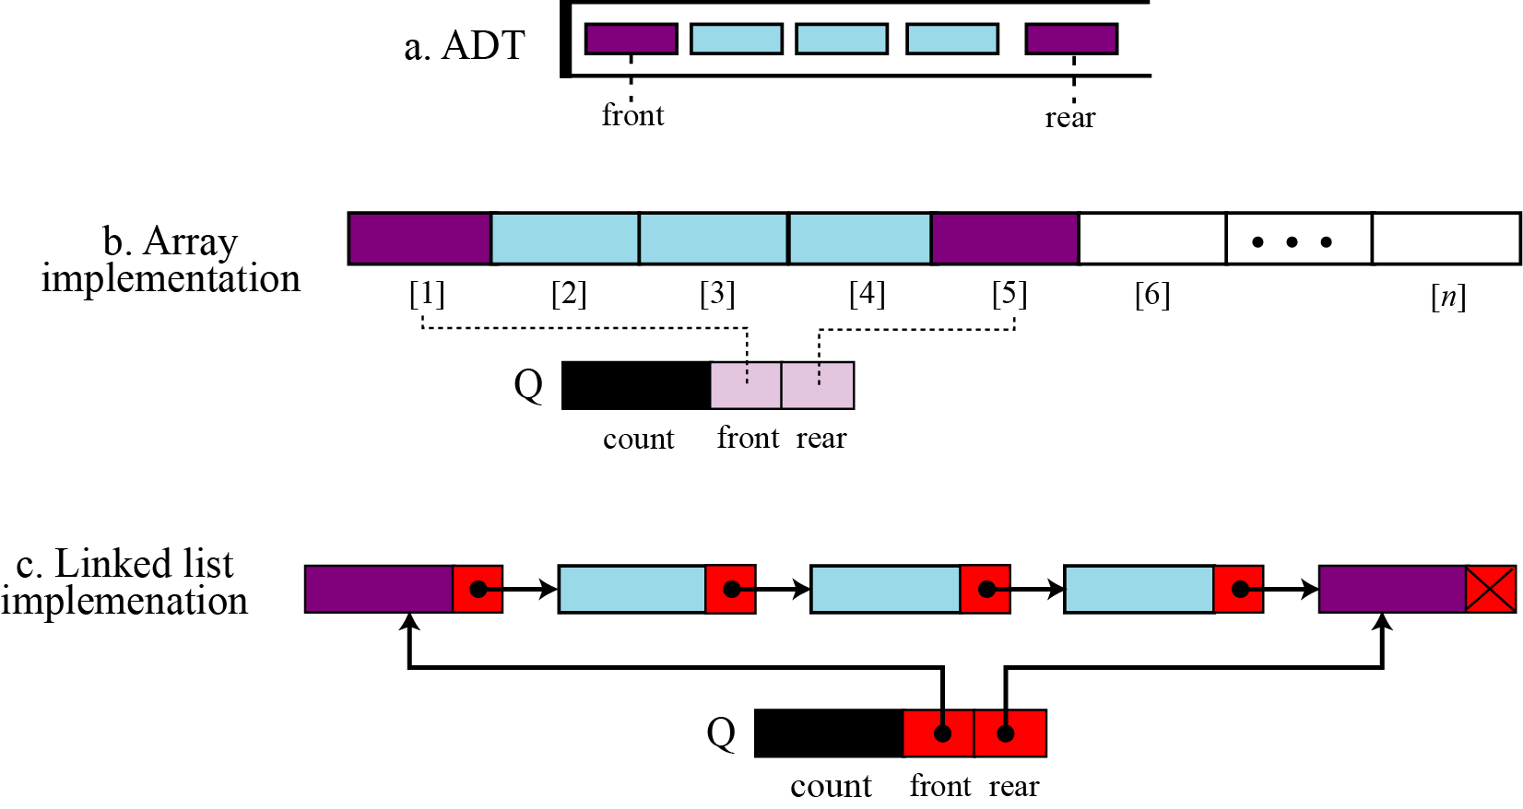
Array implementation uses a record with three fields
First field stores number of data items in queue
Second field stores index of the front element
Third field stores index of the rear element
Figure 12.13 Queue implementation

Slide 16
Linked list implementation uses a similar record
First field stores number of data items in queue
Second field is a pointer to the front element
Third field is a pointer to the rear element
Figure 12.13 Queue implementation

Slide 17
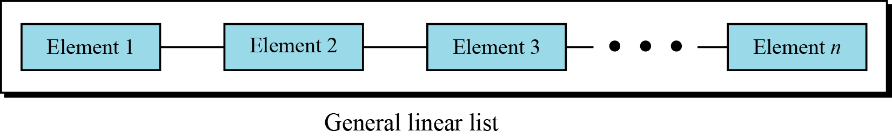
12-4 GENERAL LINEAR LISTS
Stacks and queues are restricted linear lists
A general linear list is a list in which operations
For example insertions and deletions
Can be done anywhere in the list
At the beginning, in the middle, or at the end
We also assume that data in the list is sorted
Figure 12.14 General linear list

Slide 18
12.4.1 Operations on general linear lists
Six common operations
The list, insert, delete, retrieve, traverse, and empty operations
The list operation
The list operation creates an empty list

Slide 19
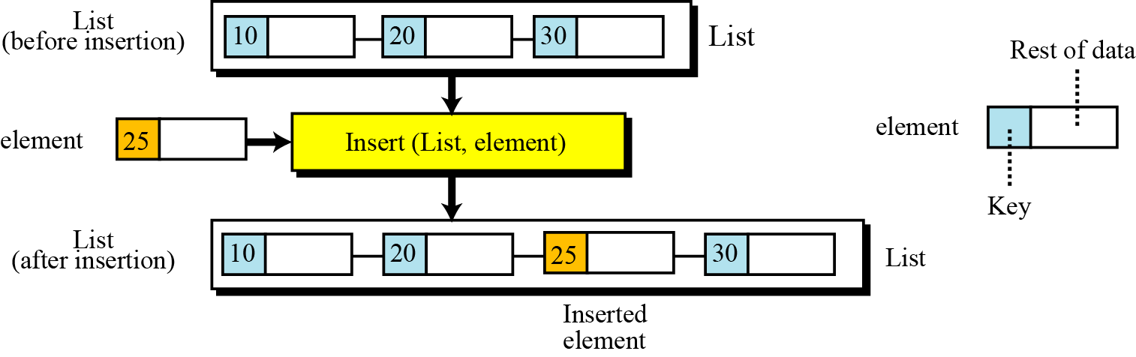
The insert operation
We assume that data elements are sorted
Insertion must be done so that order is maintained
Must determine where the element is to be placed
Searching is needed
At the implementation, not the ADT level
Figure 12.15 The insert operation

Slide 20
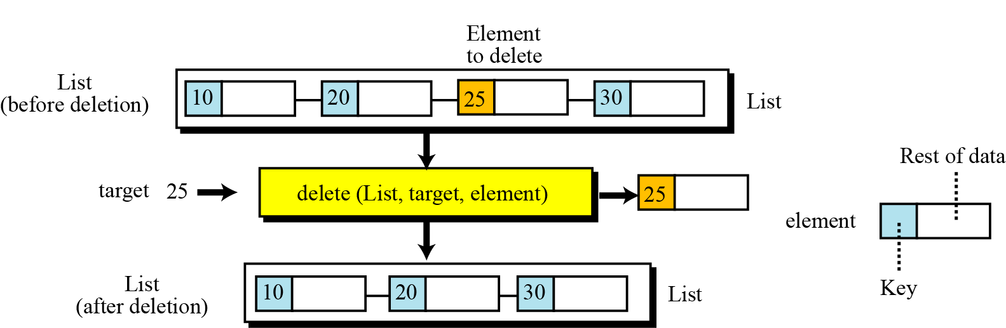
The delete operation
Search must be performed to locate the data to be deleted
After data is found, deletion can be done
Figure 12.16 The delete operation

Slide 21
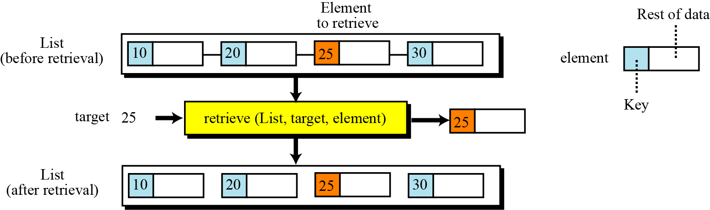
The retrieve operation
The retrieve operation accesses a single element
First search the general list
If the data is found, it can be retrieved
Figure 12.17 The retrieve operation

Slide 22


The traverse operation
Previous operations involve
A single list element
Randomly accessing the list
List traversal involves
Sequential access
All elements in the list are processed one by one
The empty operation
The empty operation checks the status of the list
Returns true if the list is empty
Returns false if the list is not empty

Slide 23
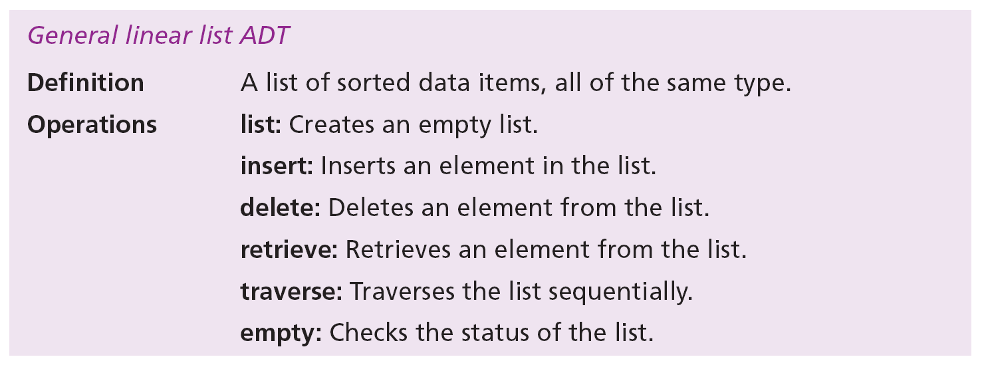
12.4.2 General linear list ADT
We define a general linear list as an ADT as follows:

Slide 24
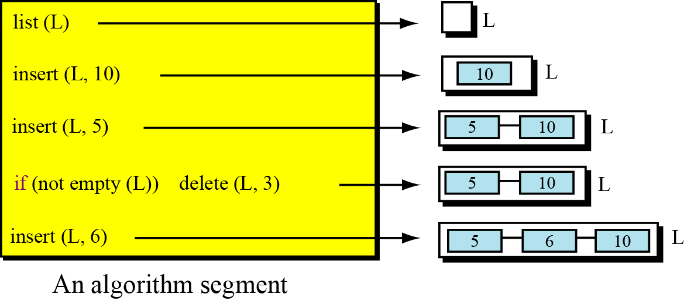
Example 12.7
A segment of an algorithm that applies the previously defined operations on a list named L
Note third and fifth operations maintain list order
Fourth operation does not delete an item
The value 3 is not in the list
Figure 12. 18 Example 12.7
, x)
x: ?
x: ?

Slide 25
12.4.3 General linear list applications
General linear lists are used when
Elements are accessed randomly or sequentially
For example, in a university
Linear list can be used to store information about students who are enrolled in each semester

Slide 26
Example 12.8
A university has a general linear list
Holds information about the students
Each data element is a record with three fields
ID
Name
Grade
We need an algorithm to change a student’s grade
Delete operation removes an element from the list
Target is the ID of the student
Makes element available to allow grade change
Insert operation adds changed element back into list

Slide 28
Example 12.9
Continuing with the previous example
We need an algorithm to print all student records
Assume the Print algorithm prints record contents
For each node, the traverse operation
Calls the Print algorithm
Passes data to be printed to the Print algorithm

Slide 30
12.4.4 General linear list implementation
At the ADT level
We use the list and its six operations
At the implementation level
We need to choose a data structure to implement it
A general list ADT can be implemented using
An array or
A linked list

Slide 31
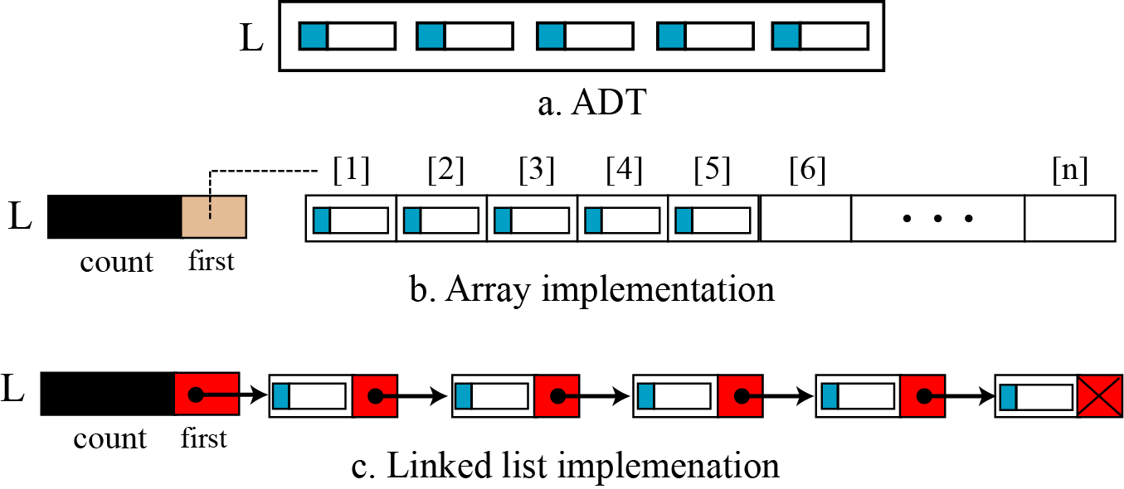
Array and linked list implementations
Use same record structure as stack implementations
Figure 12.19 General linear list implementation

